Slide 1










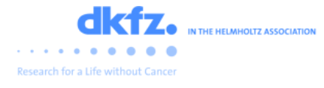
Modelling methods in the MESI-STRAT project
Metabolic Signalling Stratification
Dr Ciaran Welsh
Newcastle University

Slide 2
Overview
Introduction to the MESI-STRAT project from a high level biological perspective
Qualitative model fitting
Random Ics and time series clustering
K-armed bandits

Slide 3
MESI-STRAT: Metabolic Signalling Stratification of Breast Cancer Patients
Breast cancer is a complex disease with mortality rates at approx. 100K per year in the EU alone
The majority of BC patients (~75-80% ) are oestrogen receptor positive (ER+) and are treated with endocrine therapies (ET), which essentially block ER related tumour growth
ET works, but ~30% of patients eventually relapse with metastatic breast cancer (MBC)
The mechanisms contributing towards ET resistance broadly include:
Loss of ER
Mutations in ER
Changes in the expression of ER coregulators
Since the mechanisms leading to ET resistance are still not well understood, many BC patients may be receiving inadequate or inappropriate treatment
The MESI-STRAT project is a large EU funded consortium of researchers collectively aimed at understanding ET resistance from a mechanistic perspective.
An emphasis is placed on understanding the complex interactions between metabolism and signalling aspects of the disease
With this better understanding, we aim to stratify BC patients to improve clinical decision making and treatment strategies

Slide 4
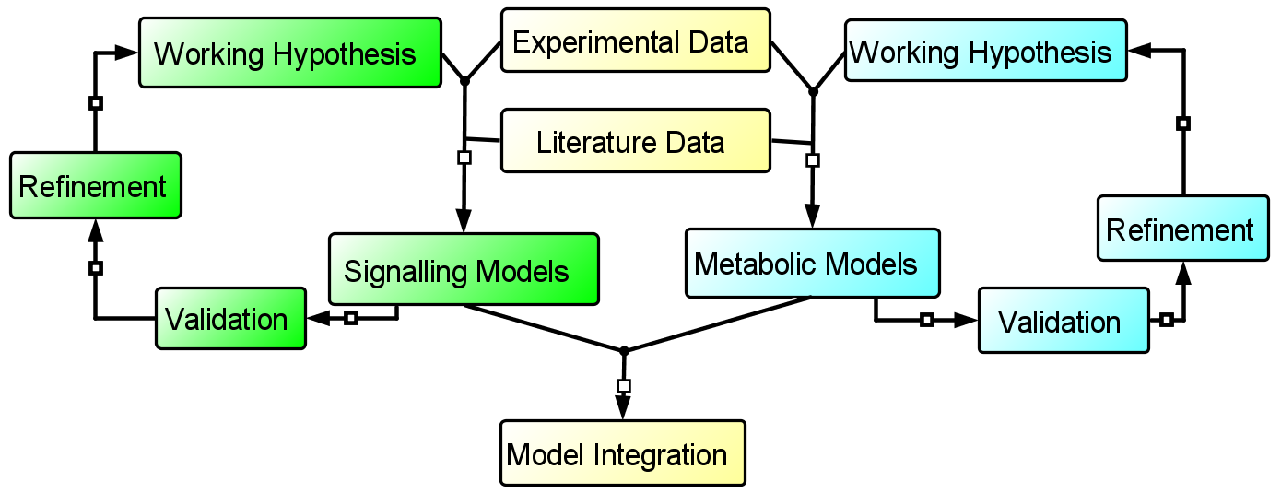
The MESI-STRAT project: An integrative systems biology project
The regulatory mechanisms that govern cell signalling, metabolism and the interactions between the two are complex
To help comprehend this complexity, the essential biology is abstracted into mathematical frameworks so that we can simulate biological processes
These models depict our working hypothesis of a biological process and are refined when invalidated, either with our own experiments or by literature findings
Using these models, we predict the dynamics of key network components in order to understand their behaviour in different biological contexts

Slide 5
Systems modelling
The normal process of building an ODE model is sometimes too rigorous and too demanding for the available data
The “normal process”:
Make sure you are clear about the question you want to answer. No question? There is no point building a model.
Do some reading and understand the biological mechanisms you want to model.
This is a focus on the important interactions that drive the biology.
Ideally you should be in communication with an expert in the field.
Abstract important features from the biology into a network.
The topology of the model is the most important part of the modelling process.
When you believe the model is behaving in accordance with your data and literature, proceed to parameter estimation.
Build your objective function. Use the residual sum of squares (RSS) objective function to measure the discrepancy between model predictions and experimental data.
This must sum over all time points of all observables in all conditions
Ideally normalised by experimental error, but other normalisation options are also available.
Could also use the likelihood function in the baysian setting (monte carlo techniques)
Use an algorithm to minimize the RSS. You have hill climbers (local) and a bunch of global stochastic algorithms (evolutionary inspired, thermodynamics inspired)
Optional: validation data as early stopping criteria.
When you are overfitting your training data, your model looses its ability to generalise – which here is measured by the validation data.
You stop fitting when your ability to fit the validation data gets to a certain threshold (i.e. larger than 10)
This is common practice in machine learning but not seen as much in systems biology.
If your model does not fit the data (most of the time it doesn’t), you need to revise the previous steps:
Algorithm, algorithm settings, model topology, mapping of variables, weighting function
You should probably do an identifiability analysis at this point
… and a sensitivity analysis for good measure

Slide 6
Qualitative Model Fitting: A focus on qualitative model behaviour
However, by focusing on model behaviour, rather than on finding the parameters, we can omit the mathematical rigour of optimization and identifiability analysis in favour of ensuring the behaves well in accordance with data and literature (i.e. the model is well validated)
This is the focus of a software package I’m currently developing (called QualitativeModelFitting (qmf))
Qmf is essentially a unit testing framework for validation of ODE models in systems biology.
Qualitative observations (i.e. from data or literature) are encoded the syntax of a (yet unnamed) language I invented
The language is interpreted by a pure Python lexer and parser called LARK.
TestCase classes and methods are dynamically generated at run time to test the observation
Hence, an arbitrary number of qualitative observations can be validated simultaneously and highlight important discrepancies with literature findings.
I have a prototype of the code base that requires expanding
The package will have two font ends:
A manual interface for testing observations and manually tweaking the model (currently implemented)
An automatic interface that locates ensembles of parameter sets that are consistent with the observations (not yet implemented)
Involves designing an objective function that will be
Minimized using standard optimization algorithms (such as hill climbers or evolutionary strategies)
Maximized by a reinforcement learning algorithm (Deep Q-learning based)
Also have the potential for a dual objective function, incorporating both qualitative and quantitative methods.

Slide 7
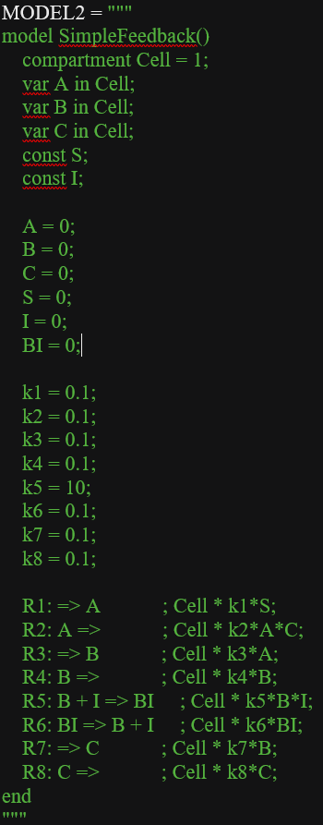
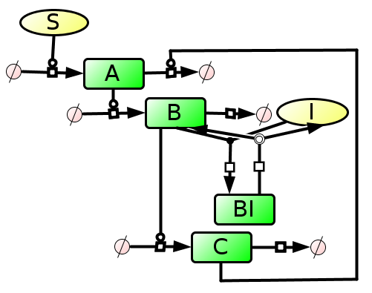
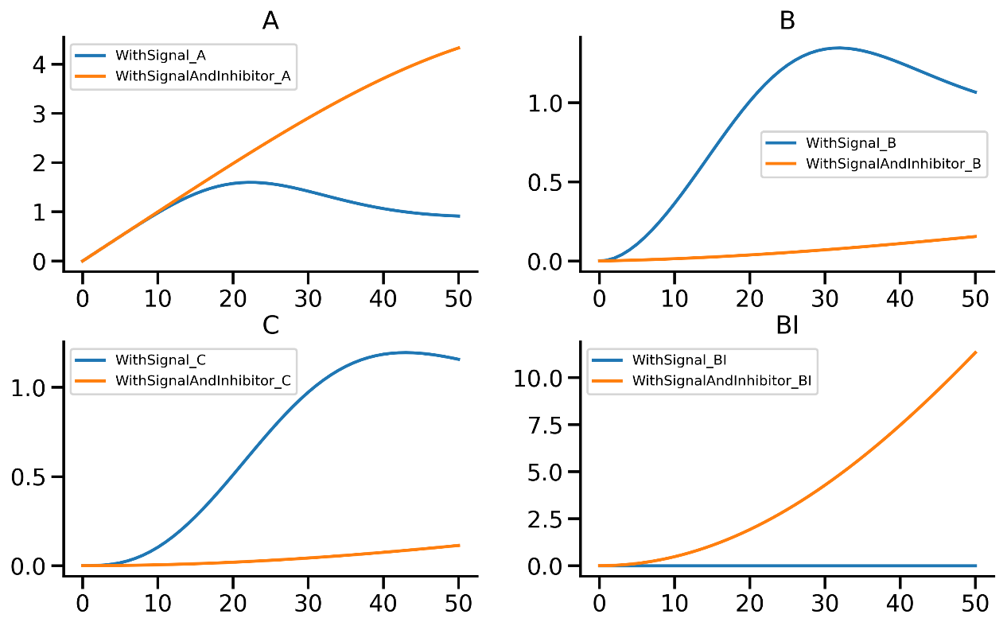
A toy model

Slide 8
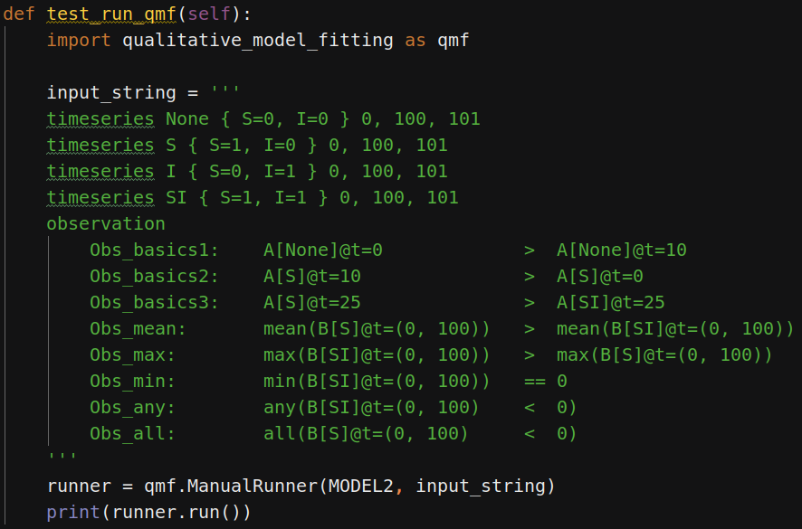

Slide 9
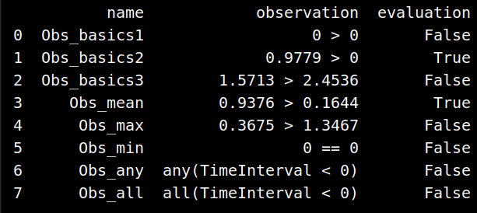

Slide 10
Future directions
Enable steady state blocks
Enable sensitivity blocks
Enable dose response blocks
Enable qualitative features to be queried
Hyperbolic, sigmoidal, transient, directional (i.e. up or down)
i.e.: `obs1: hyperbolic up A[S]`
Could be done with a classification model (NN, RF, SVM?)
But may be impossible to generalise to every situation?

Slide 11
The transfer model
Kathrin has a hypothesis.
Given two data sets A and B representing the same observables measured but in two different cell lines
Observables such as AktpT308
If you calibrate an ODE model representing the PI3K system to dataset A, is it possible to use the initial concentrations of dataset B to reproduce the dynamics of cell line B?
With scepticism, I have tried this several times now and I’ve not been able to get it to work (as I predicted)
There are some major issues with this idea
Identifiability.
The assumption is that were able to fully calibrate a model with what actually is quite a limited dataset (despite being a huge amount of work experimentally).
This is NOT the case. Imprecision regarding model parameters directly impedes the transfer problem
Relative data.
ODE models work because they allow us to quantitatively capture the relationship between interacting parts of a network.
Relative (i.e. semi-quantitative) data is not ideal but can still be used to calibrate an ODE model – you have to make weak assumptions that cause you to make weaker predictions.
i.e. assumptions such as: working in arbitrary units, use of nuisance parameters for estimating real quantitates.
But for a transfer problem like this, we can’t make these weak assumptions.
If we work in arbitrary units then the quantitative relationship between interacting proteins is not captured and the model wont generalise well to new data.
If we try to estimate real quantities, then we need to make them good estimates because … well because of the “shit in – shit out” principle.

Slide 12
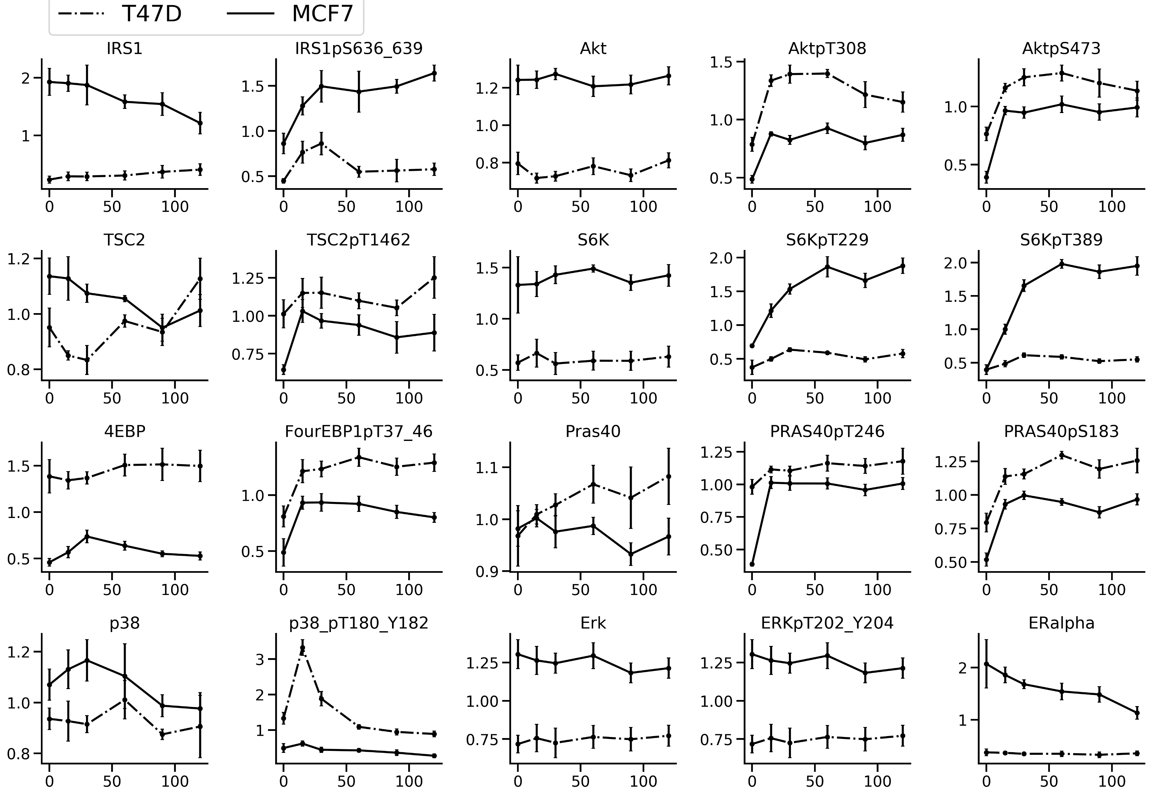

Slide 13
Random Initial Concentrations
A theoretical way to investigate the feasibility of this problem may be to look at a network’s behaviour given random initial concentration parameters.
The hypothesis is that model trajectories can only exhibit a finite number of qualitative behaviours.
Therefore, it may be possible to perform many simulations from random initial concentrations and then cluster the resulting time series objects
I wrote some code to test this hypothesis

Slide 14
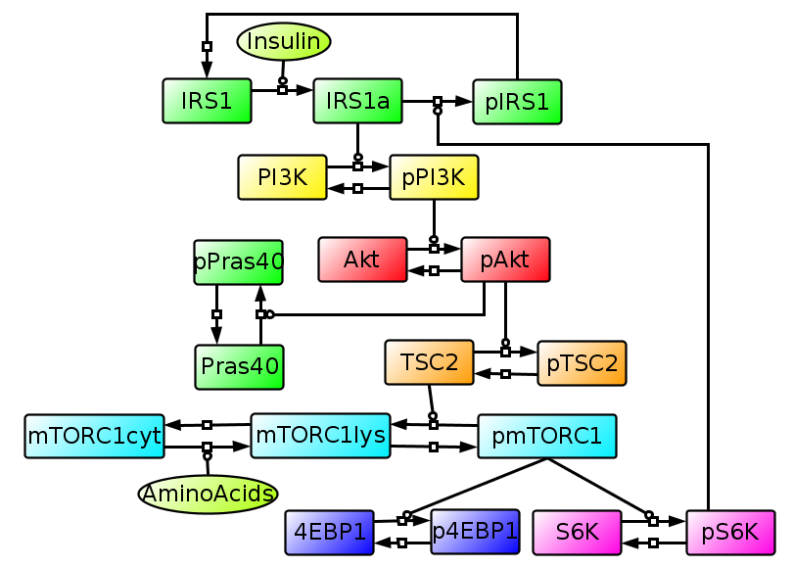
Random Initial Concentrations
The model: The same as in the transfer problem.
All kinetic parameter were fixed to 0.1
IC parameters were randomized using Latin-Hypercube Sampling (LHS) from a uniform distribution between 0.1 and 10.
LHS ensures even sampling of parameter space.

Slide 15
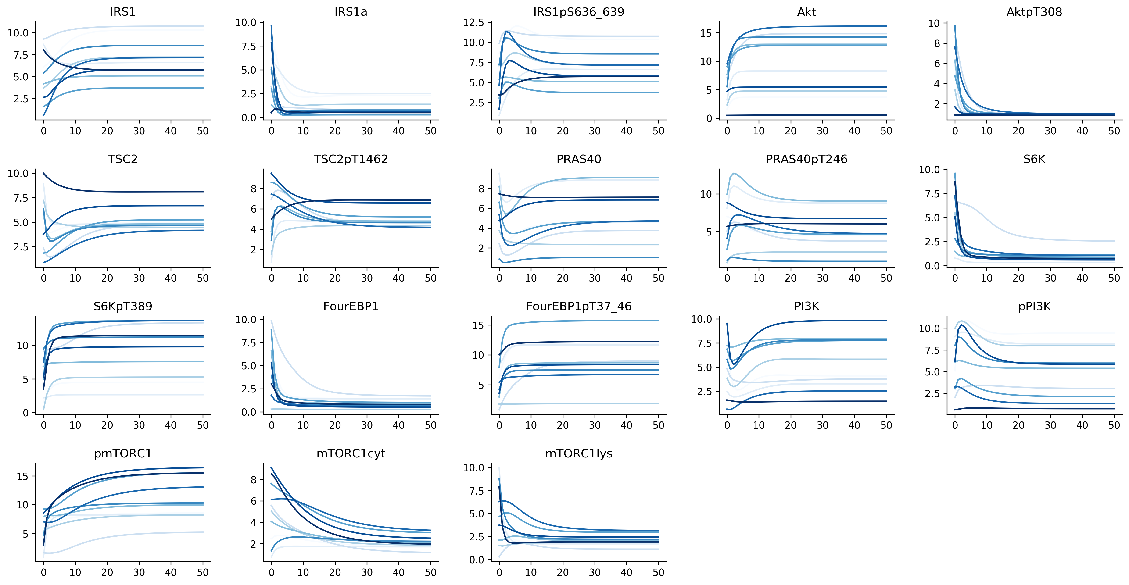
Random Initial Concentrations (n=10, between 0.1 and 10)

Slide 16
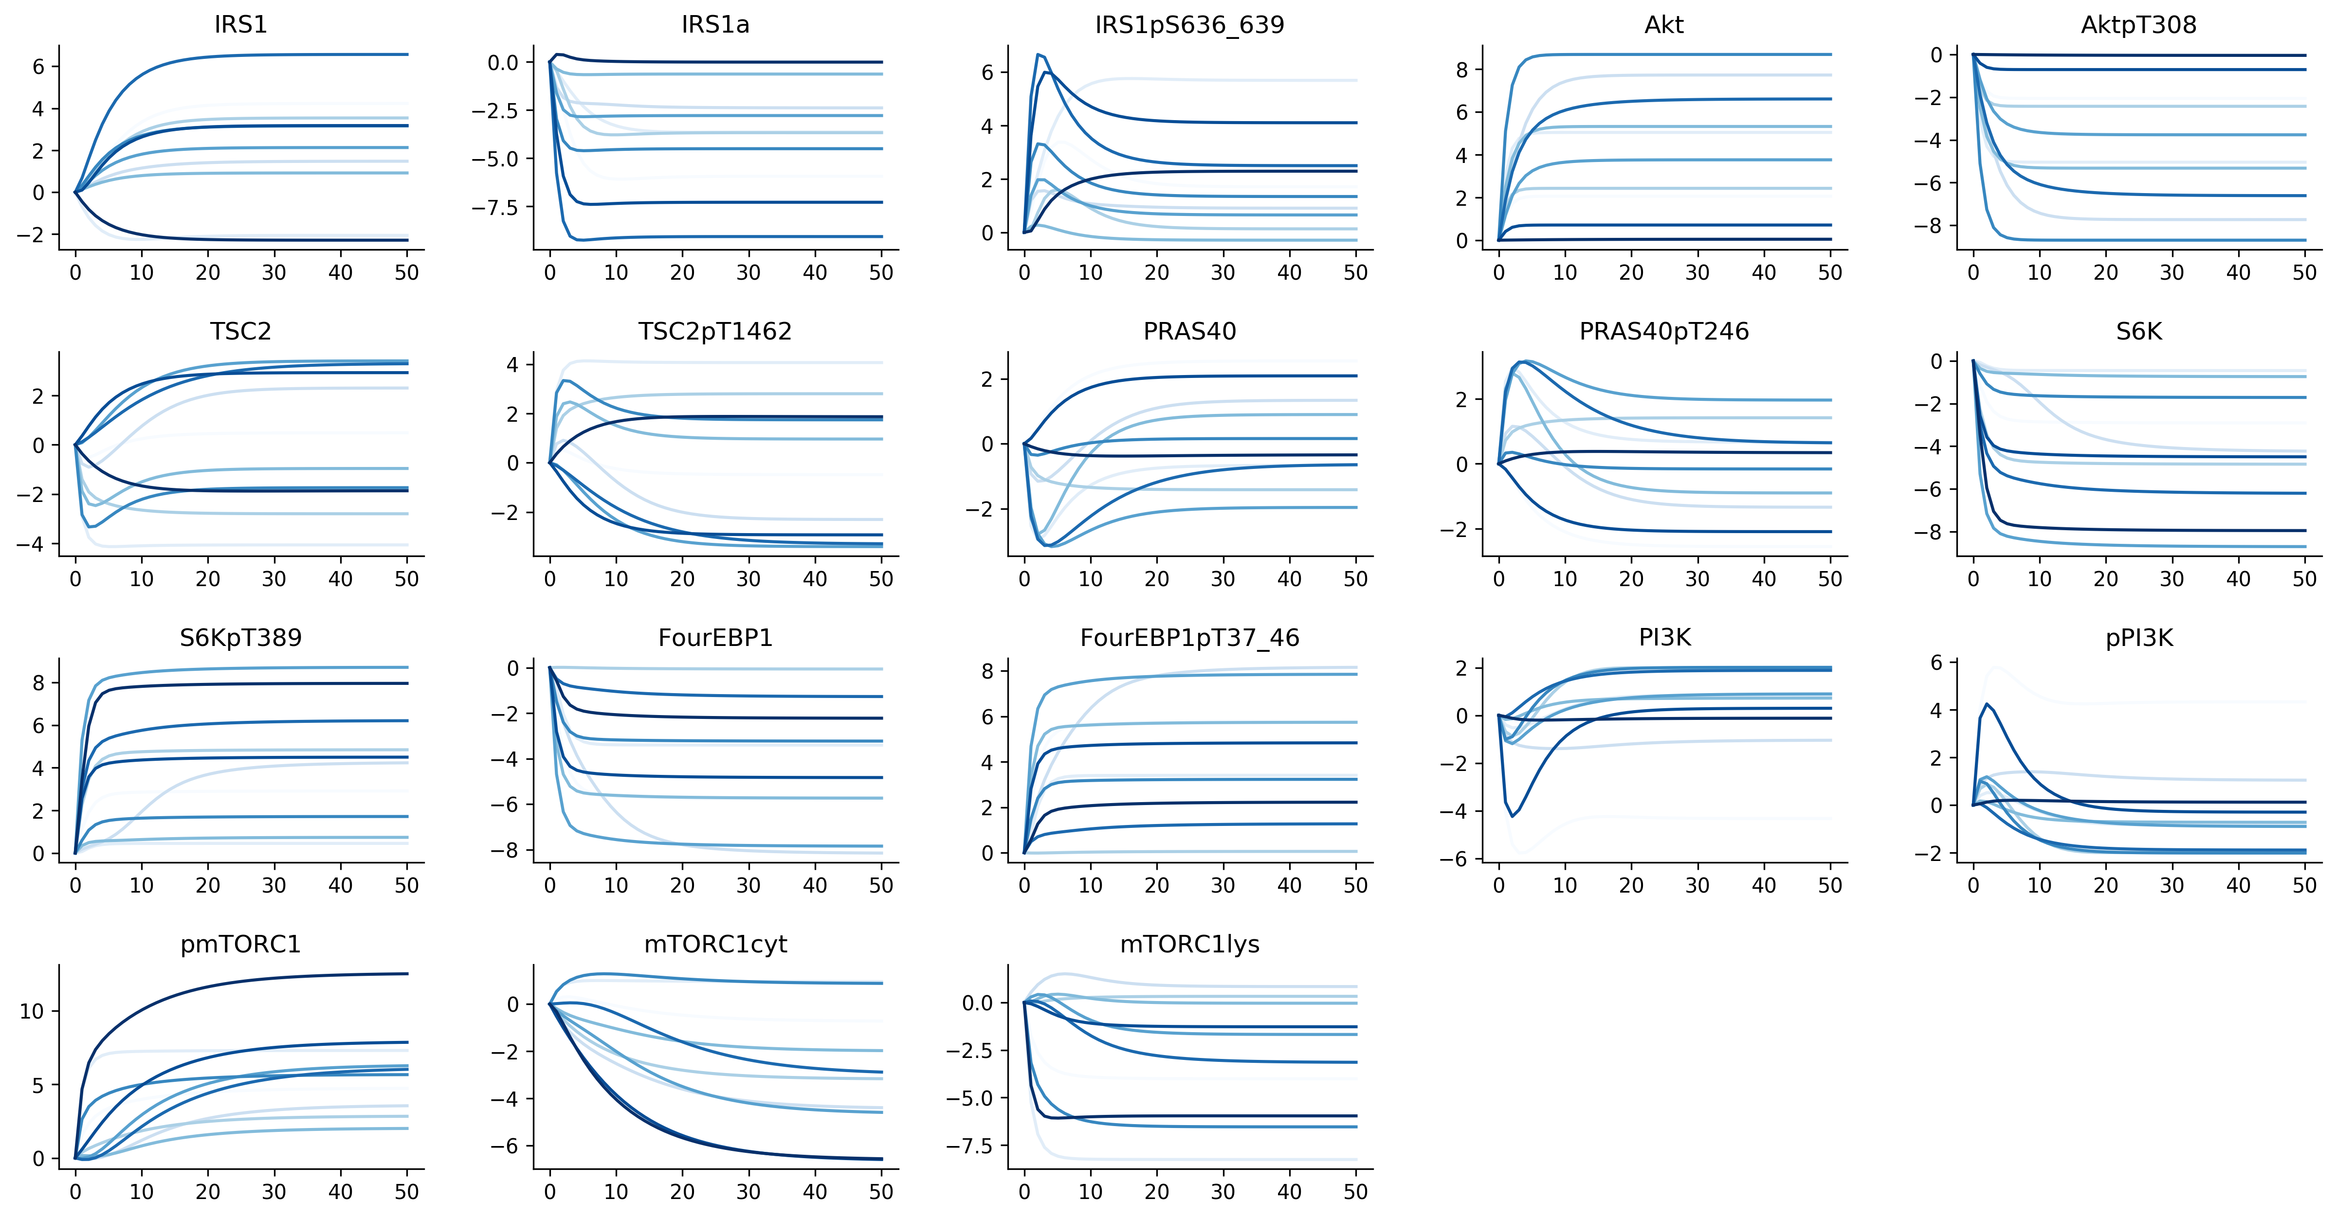
Random Initial Concentrations: Normalisation
For clustering, the data has been normalised by subtracting the initial concentration parameter. This is by no means the only normalisation available and others are certainly worth trying.

Slide 17
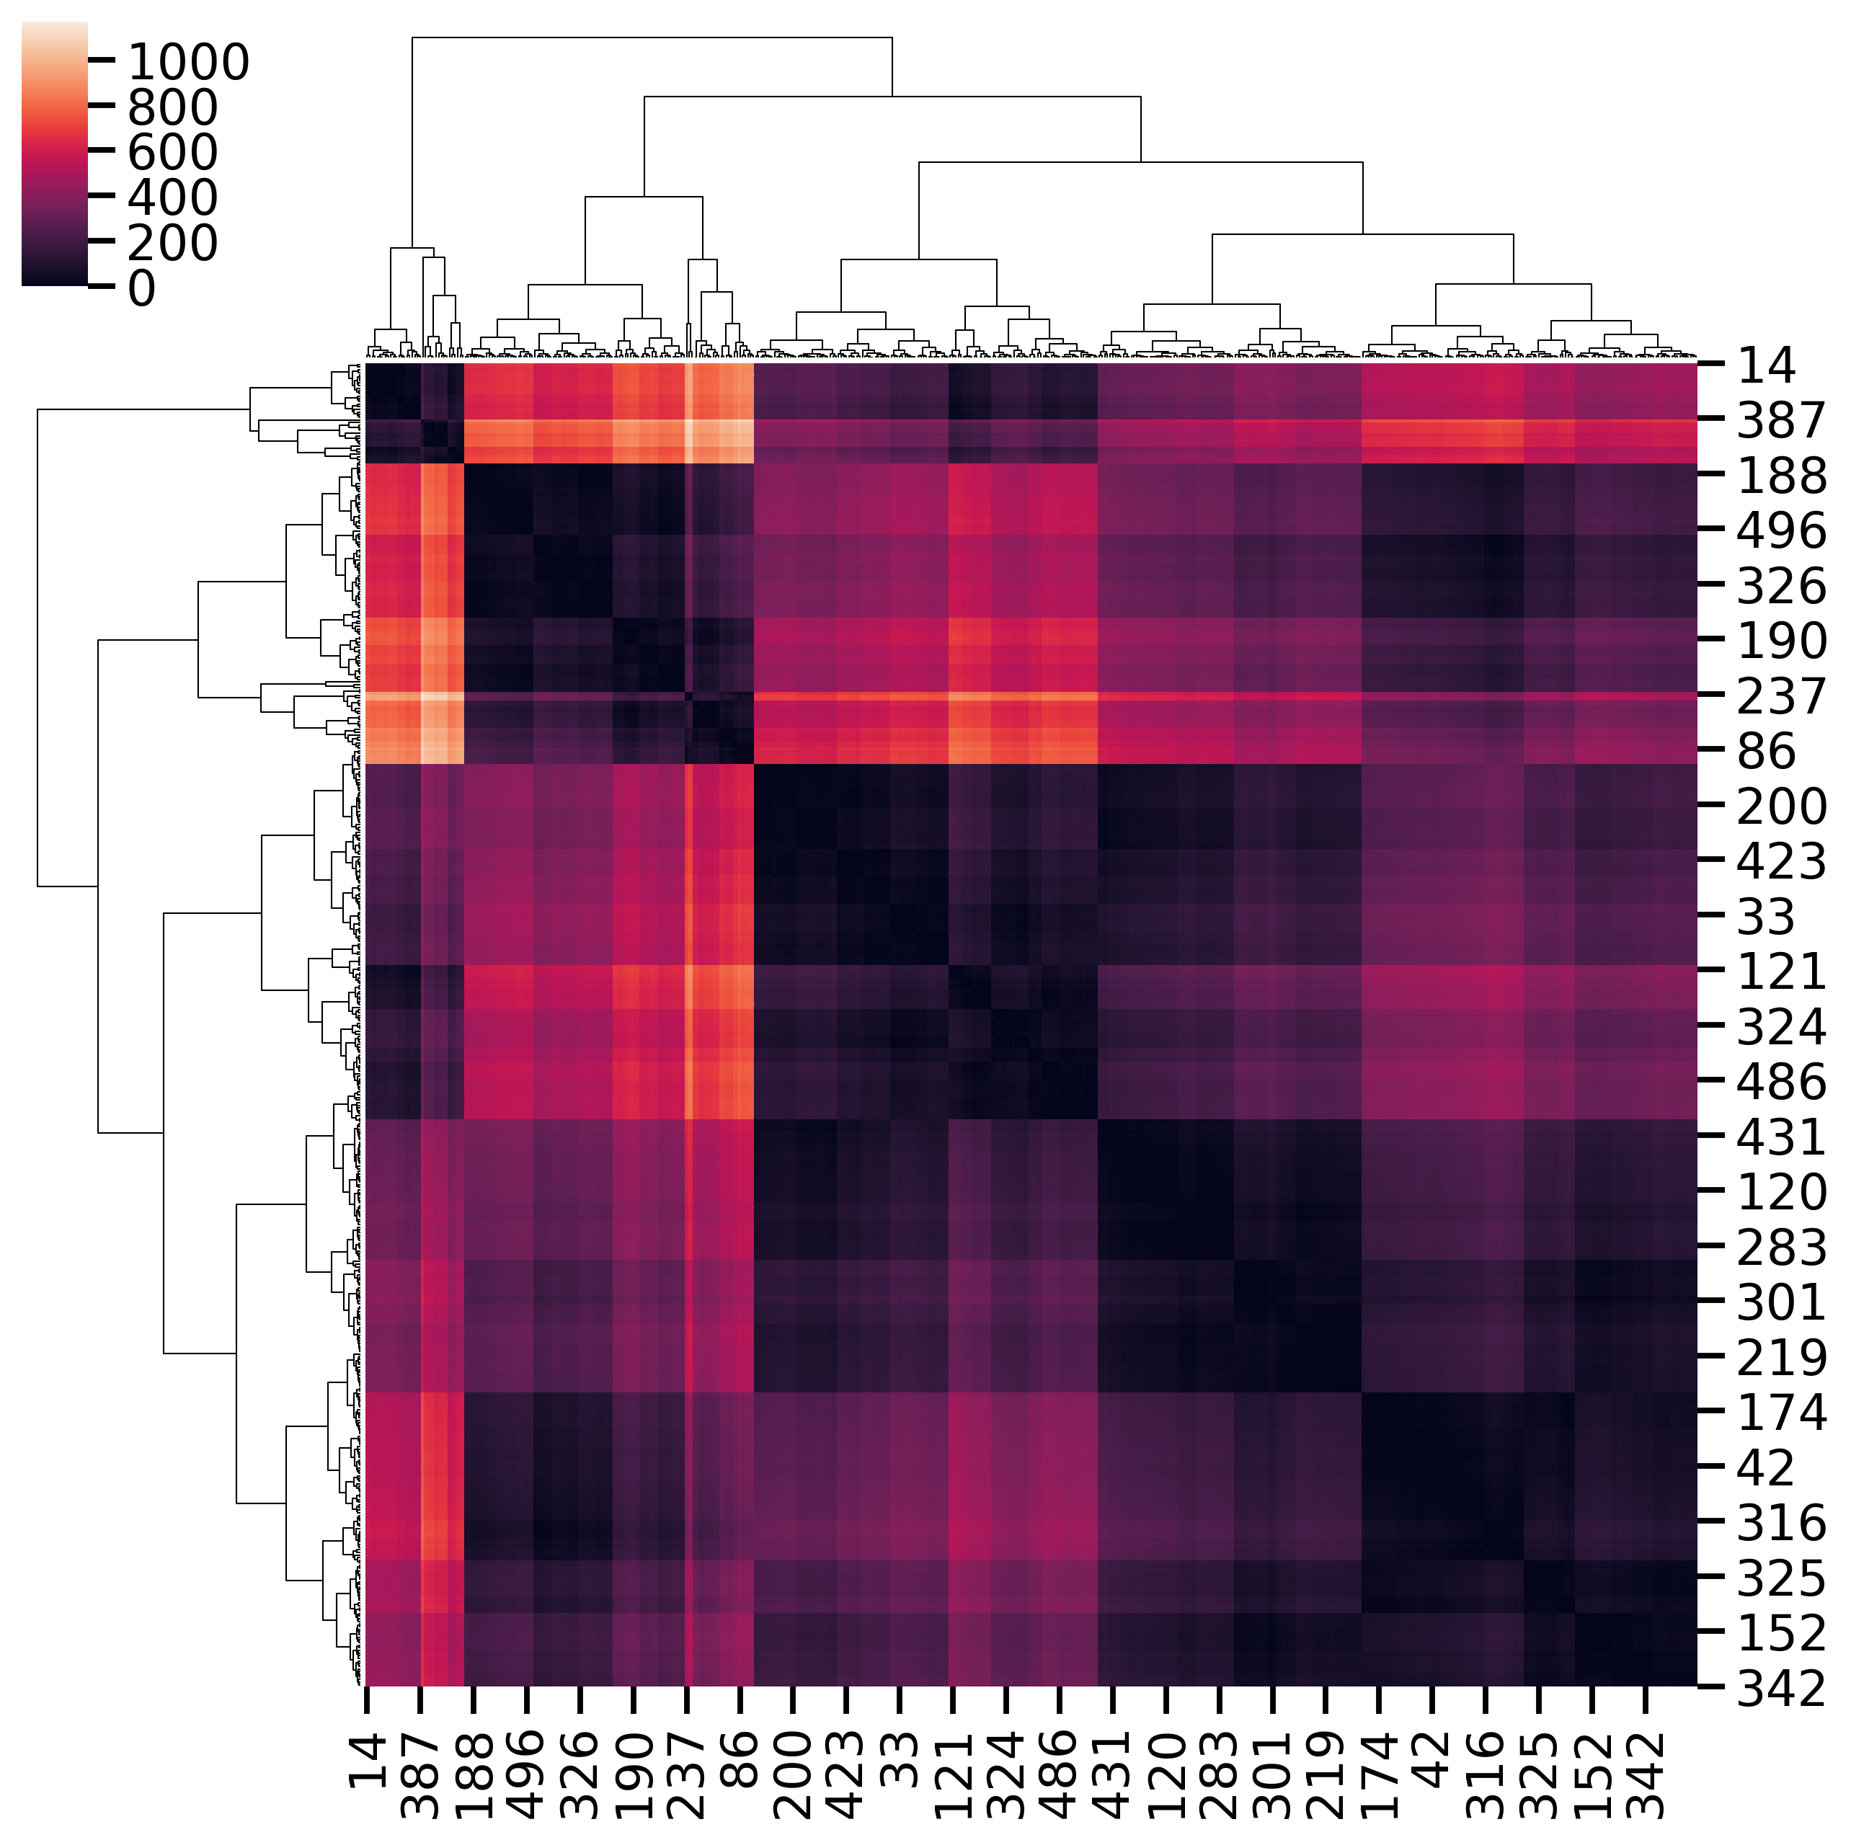
Time series clustering
IRS1
Time series clustering is a hard problem
I’ve tried a few things, but the problem really isn’t resolved.
Using dynamic time warping
Compute dtw distance between all pairs of time series.
Similar time series have a lower DTW (dark on the heatmap, right)
Does produce clusters, but quite difficult to interpret.
(should have extracted the clusters and produced plots, but haven’t yet)
Problems with the approach:
Computationally very expensive, and this is for just one protein
It is not clear how to do joint clustering between the different simulation runs.

Slide 18

Multi-variate time series clustering
Remembering that I actually have a multivariate time series clustering problem, which is even harder
Idea: first use feature extraction methods to describe the dynamic data and then cluster that instead
I found a Python package that specialises in extracting features from time series
The time series data has dimensions: (500x18)
After feature extraction and dropping NaN columns and columns whereby all values are 1, we have a (10 x 7009) matrix.
We have gone from long and thin to fat and short.

Slide 19
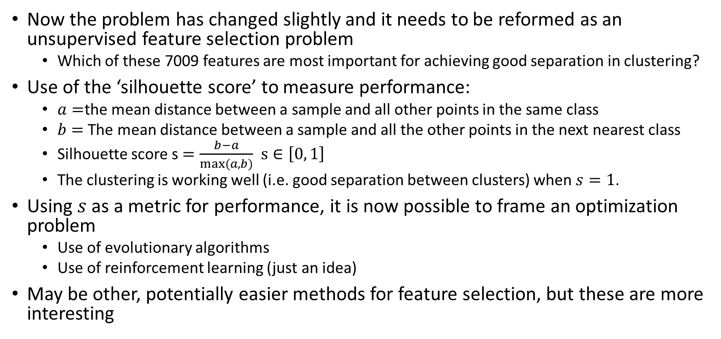
Feature selection for unsupervised learning
Now the problem has changed slightly and it needs to be reformed as an unsupervised feature selection problem
Which of these 7009 features are most important for achieving good separation in clustering?
Use of the ‘silhouette score’ to measure performance:
$a=$the mean distance between a sample and all other points in the same class
$b=$ The mean distance between a sample and all the other points in the next nearest class
Silhouette score s $=\frac{b−a}{max⁡(a, b)}$ $s∈\left[0, 1\right]$
The clustering is working well (i.e. good separation between clusters) when $s=1$.
Using $s$ as a metric for performance, it is now possible to frame an optimization problem
Use of evolutionary algorithms
Use of reinforcement learning (just an idea)
May be other, potentially easier methods for feature selection, but these are more interesting

Slide 20
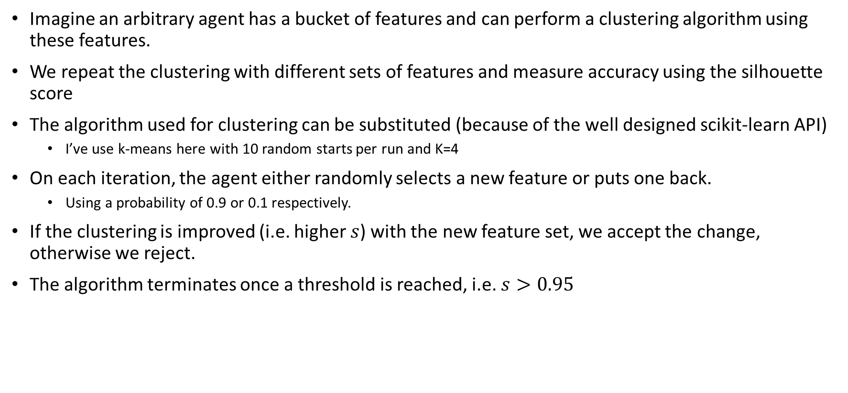
Randomization as a first take (precursor to a reinforcement learning algorithm)
Imagine an arbitrary agent has a bucket of features and can perform a clustering algorithm using these features.
We repeat the clustering with different sets of features and measure accuracy using the silhouette score
The algorithm used for clustering can be substituted (because of the well designed scikit-learn API)
I’ve use k-means here with 10 random starts per run and K=4
On each iteration, the agent either randomly selects a new feature or puts one back.
Using a probability of 0.9 or 0.1 respectively.
If the clustering is improved (i.e. higher $s$) with the new feature set, we accept the change, otherwise we reject.
The algorithm terminates once a threshold is reached, i.e. $s>0.95$

Slide 21
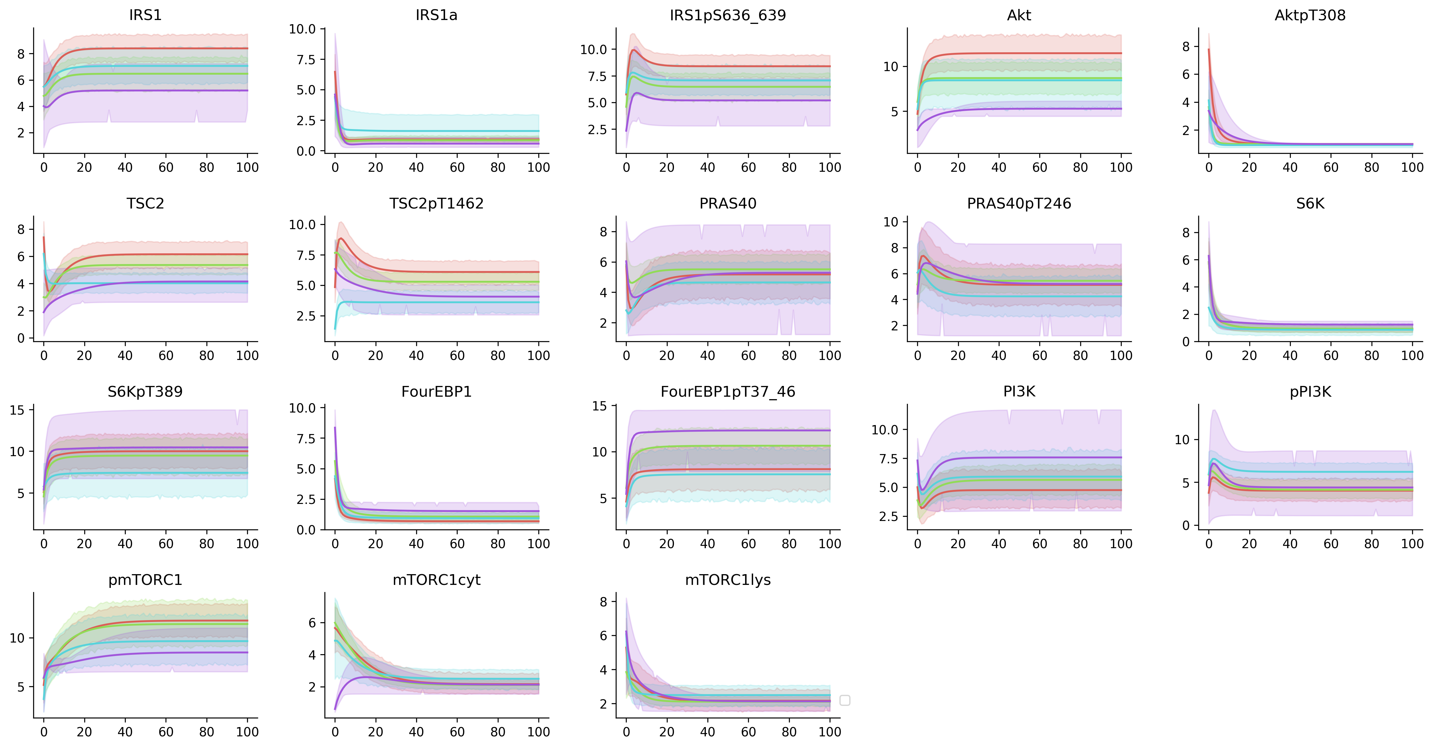
Without normalisation

Slide 22
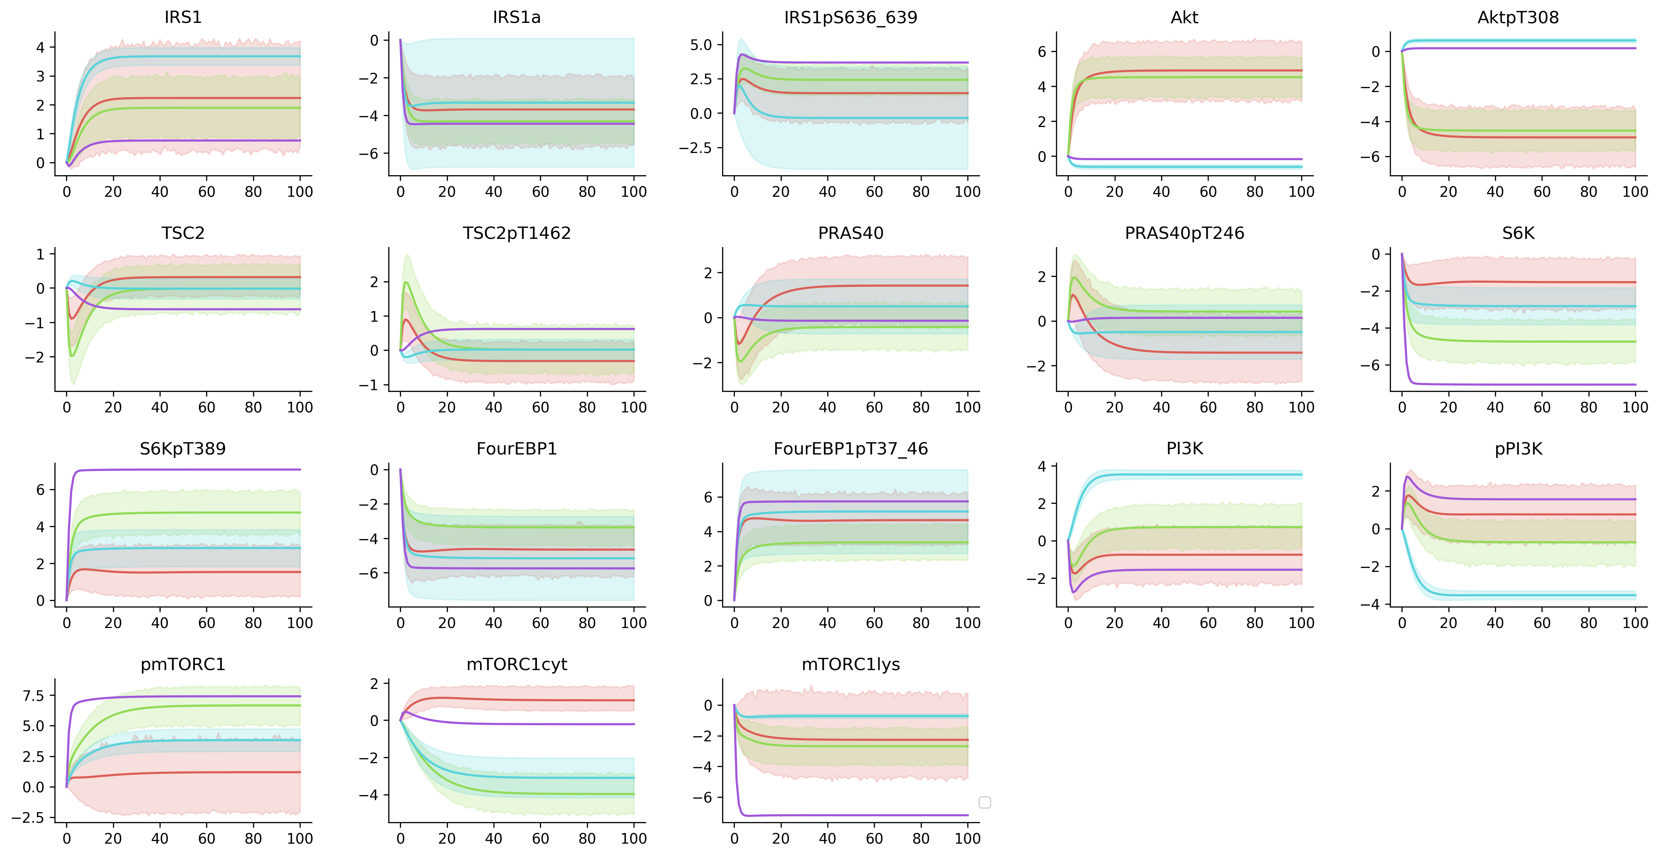
With normalisation (by subtracting the t=0 from everything)

Slide 23
Problems
This strategy is not ideal
Small number of features tend to perform quite well (>0.8)
Treats all features as equal, rather than picking evenly from features from each profile
Evolutionary and RL strategies may do better!

Slide 24

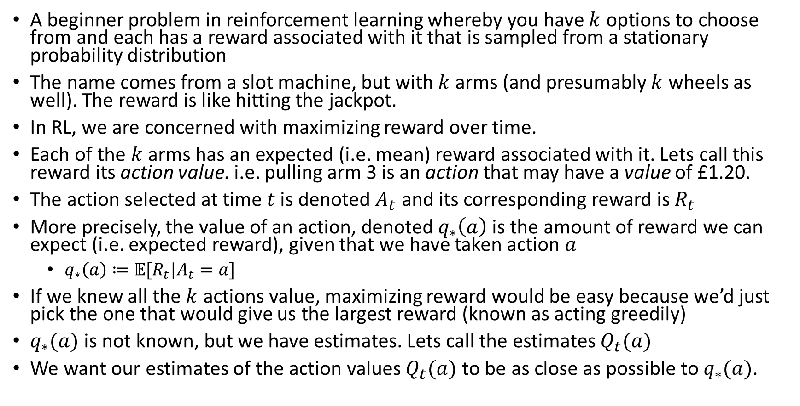
$K$-armed bandits (example from Sutton and Barto)
A beginner problem in reinforcement learning whereby you have $k$ options to choose from and each has a reward associated with it that is sampled from a stationary probability distribution
The name comes from a slot machine, but with $k$ arms (and presumably $k$ wheels as well). The reward is like hitting the jackpot.
In RL, we are concerned with maximizing reward over time.
Each of the $k$ arms has an expected (i.e. mean) reward associated with it. Lets call this reward its action value. i.e. pulling arm 3 is an action that may have a value of £1.20.
The action selected at time $t$ is denoted $A_{t}$ and its corresponding reward is $R_{t}$
More precisely, the value of an action, denoted $q_{∗}\left(a\right)$ is the amount of reward we can expect (i.e. expected reward), given that we have taken action $a$
$q_{∗}\left(a\right)≔𝔼[R_{t}|A_{t}=a]$
If we knew all the $k$ actions value, maximizing reward would be easy because we’d just pick the one that would give us the largest reward (known as acting greedily)
$q_{∗}(a)$ is not known, but we have estimates. Lets call the estimates $Q_{t}(a)$
We want our estimates of the action values $Q_{t}(a)$ to be as close as possible to $q_{∗}(a)$.

Slide 25
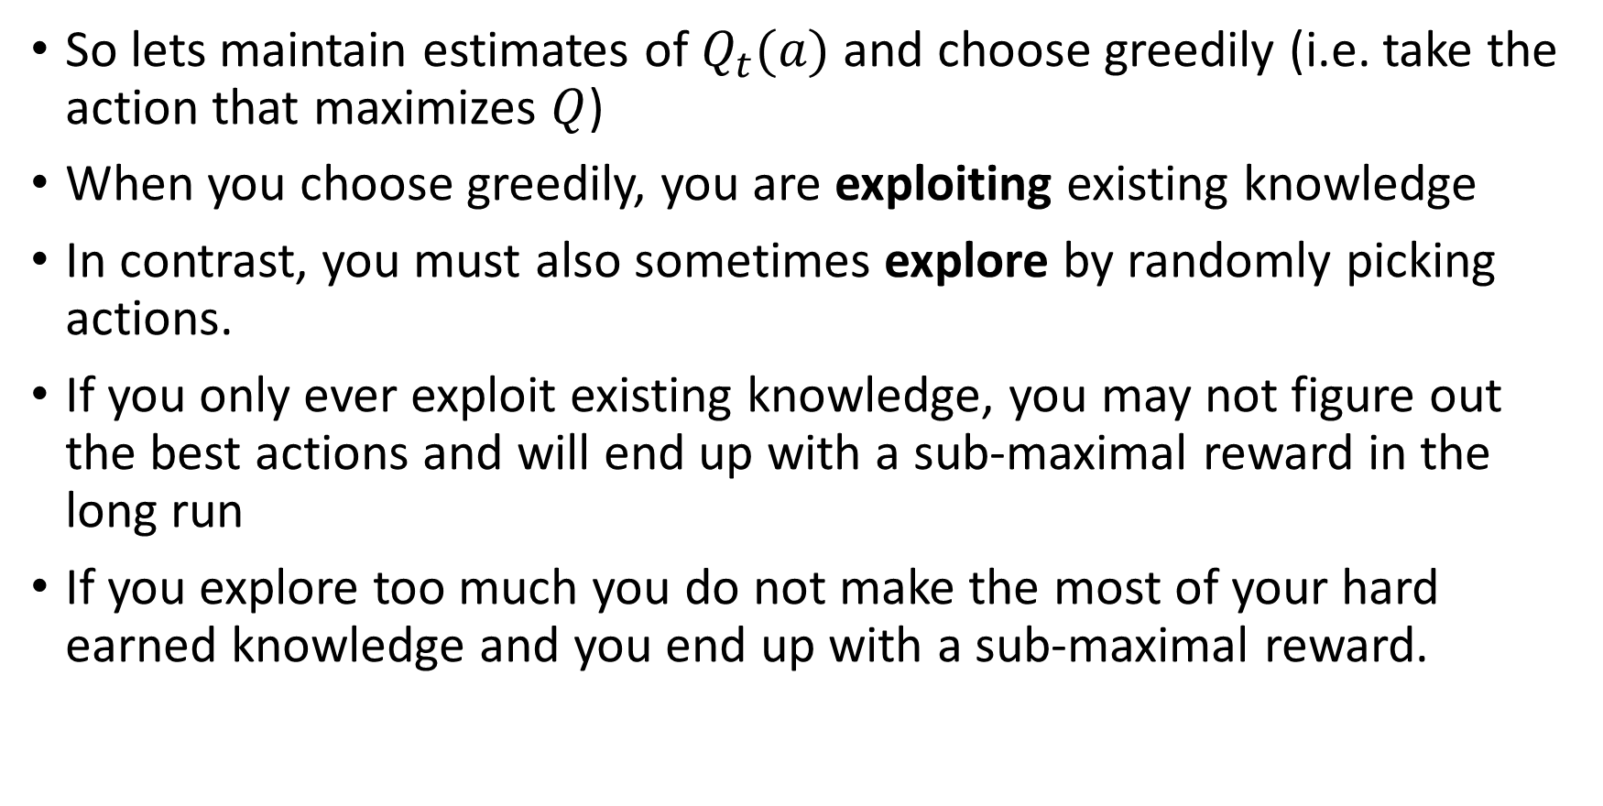
$K$-armed bandits (example from Sutton and Barto)
So lets maintain estimates of $Q_{t}(a)$ and choose greedily (i.e. take the action that maximizes $Q$)
When you choose greedily, you are exploiting existing knowledge
In contrast, you must also sometimes explore by randomly picking actions.
If you only ever exploit existing knowledge, you may not figure out the best actions and will end up with a sub-maximal reward in the long run
If you explore too much you do not make the most of your hard earned knowledge and you end up with a sub-maximal reward.

Slide 26

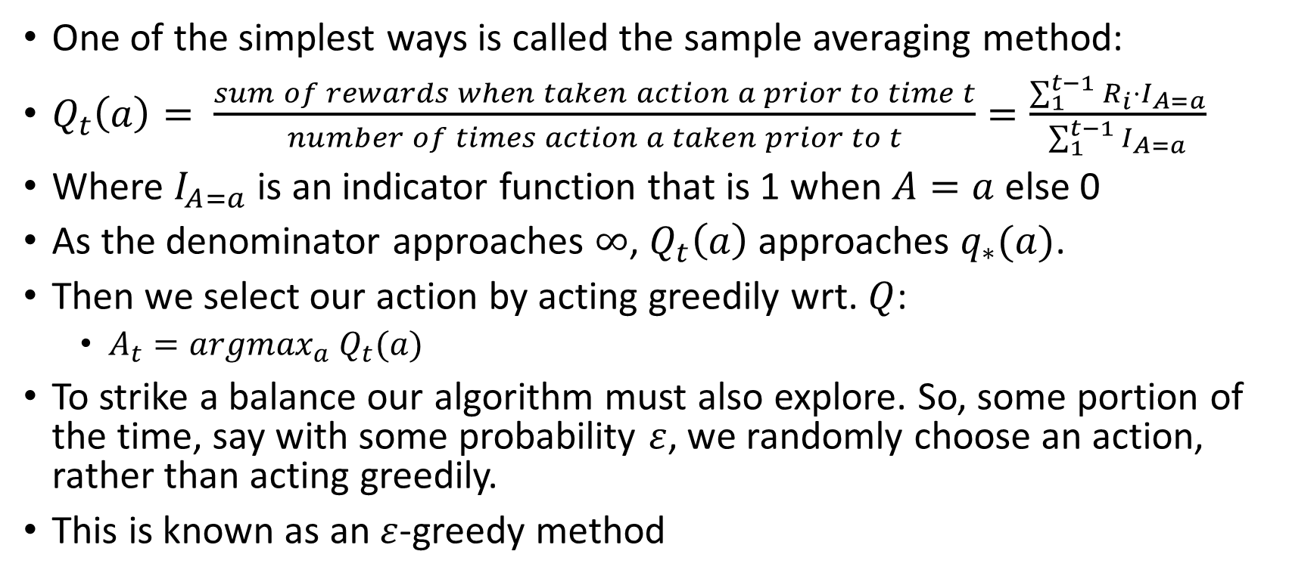
$K$-armed bandits (example from Sutton and Barto)
So how do you estimate the action value function $Q_{t}(a)$?
One of the simplest ways is called the sample averaging method:
$Q_{t}\left(a\right)= \frac{sum of rewards when taken action a prior to time t}{number of times action a taken prior to t}=\frac{\sum_{1}^{t−1}{R_{i}⋅I_{A=a}}}{\sum_{1}^{t−1}{I_{A=a}}}$
Where $I_{A=a}$ is an indicator function that is 1 when $A=a$ else 0
As the denominator approaches $∞$, $Q_{t}\left(a\right)$ approaches $q_{∗}(a)$.
Then we select our action by acting greedily wrt. $Q$:
$A_{t}=argmax_{a} Q_{t}(a)$
To strike a balance our algorithm must also explore. So, some portion of the time, say with some probability $ε$, we randomly choose an action, rather than acting greedily.
This is known as an $ε$-greedy method

Slide 27
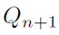
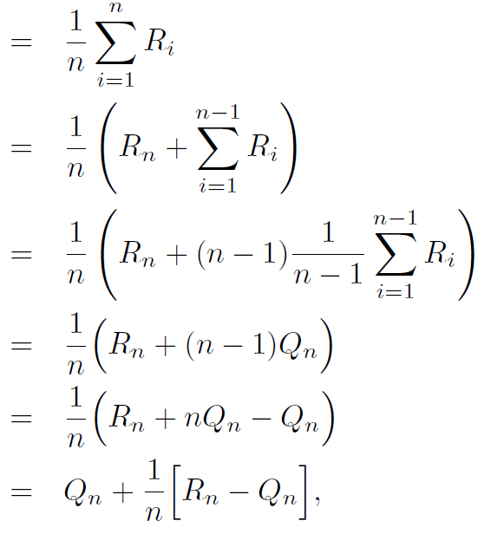
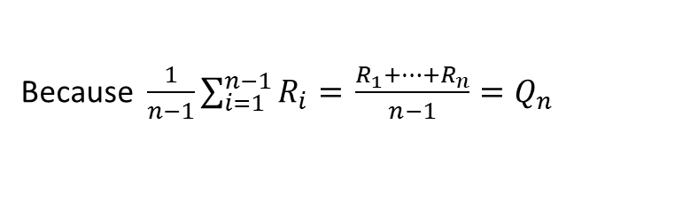

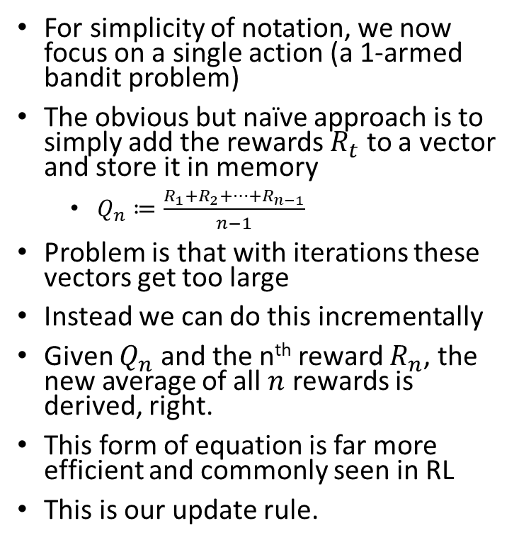
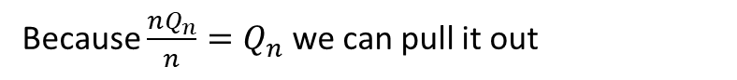
$K$-armed bandits (example from Sutton and Barto)
How do you compute the action value function $Q_{t}\left(a\right)?$
For simplicity of notation, we now focus on a single action (a 1-armed bandit problem)
The obvious but naïve approach is to simply add the rewards $R_{t}$ to a vector and store it in memory
$Q_{n}≔\frac{R_{1}+R_{2}+…+R_{n−1}}{n−1}$
Problem is that with iterations these vectors get too large
Instead we can do this incrementally
Given $Q_{n}$ and the n^{th} reward $R_{n}$, the new average of all $n$ rewards is derived, right.
This form of equation is far more efficient and commonly seen in RL
This is our update rule.
Average until n^{th} time step
Average until n-1th time step
just multiplying by 1
Because $\frac{1}{n−1}\sum_{i=1}^{n−1}{R_{i}=} \frac{R_{1}+…+R_{n}}{n−1}=Q_{n}$
Multiply out brackets
Because $\frac{nQ_{n}}{n}=Q_{n}$ we can pull it out

Slide 28
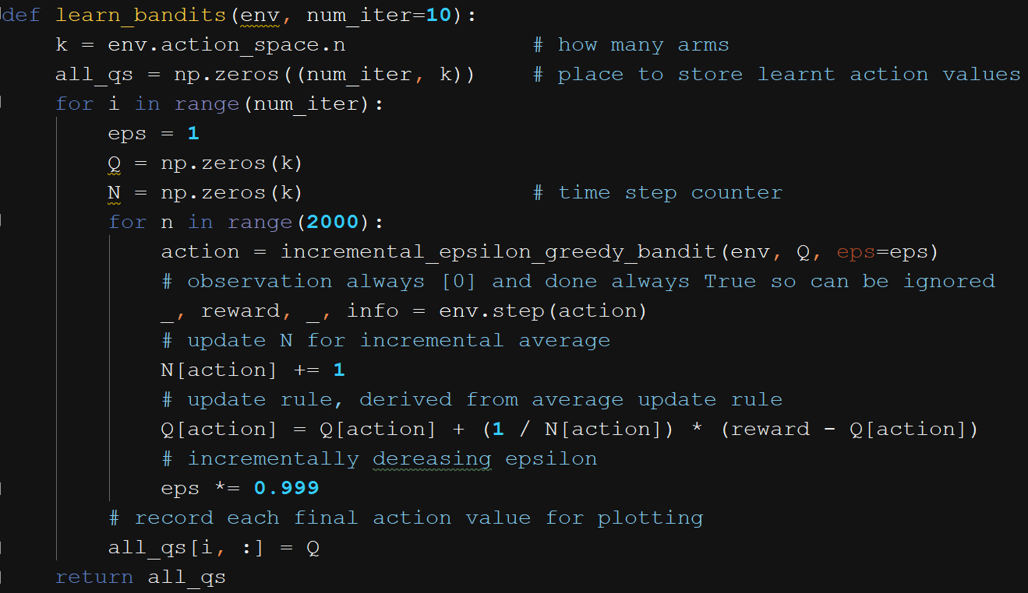
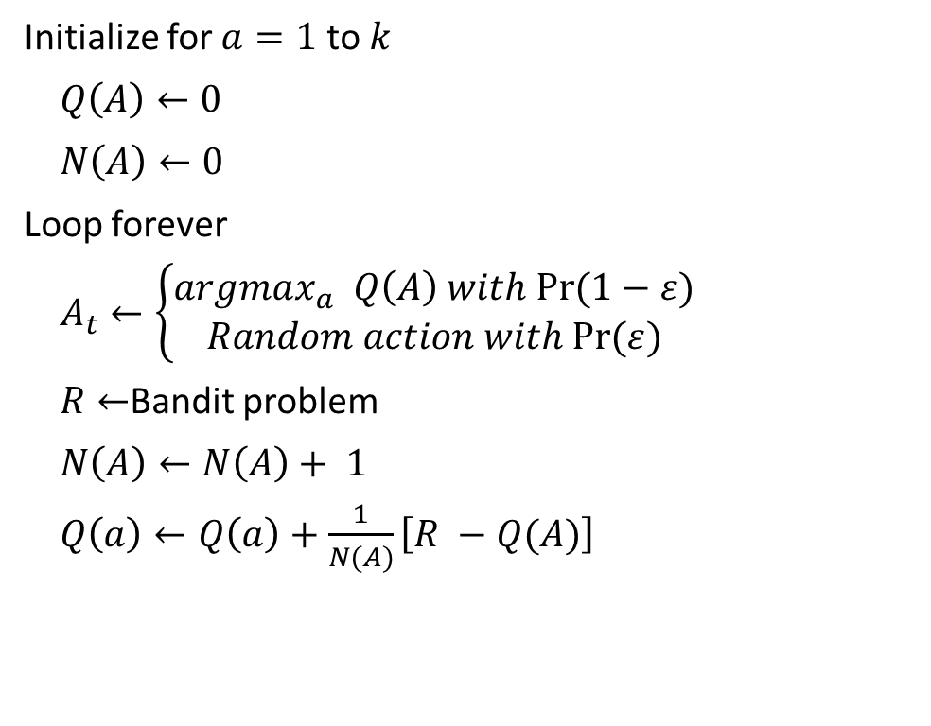
$K$-armed bandits (example from Sutton and Barto)
The final algorithm (the bandit environment is provided for us)
Initialize for $a=1$ to $k$
$Q\left(A\right)←0$
$N\left(A\right)←0$
Loop forever
$A_{t}←\left\{\begin{aligned}argmax_{a} Q\left(A\right) with Pr⁡(1−ε) \\ Random action with Pr⁡(ε)\end{aligned}\right.$
$R←$Bandit problem
$N\left(A\right)←N\left(A\right)+ 1$
$Q\left(a\right)←Q\left(a\right)+\frac{1}{N(A)}\left[R −Q(A)\right]$

Slide 29
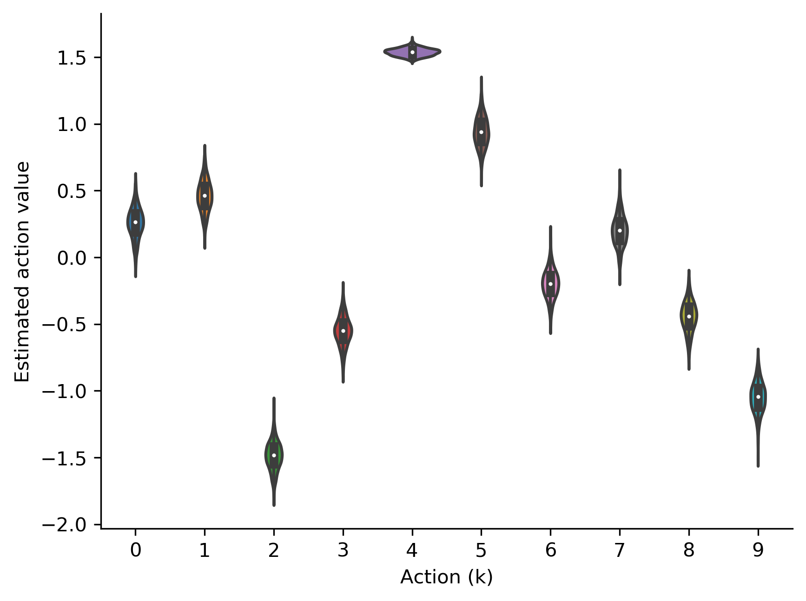
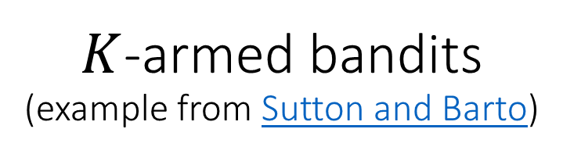
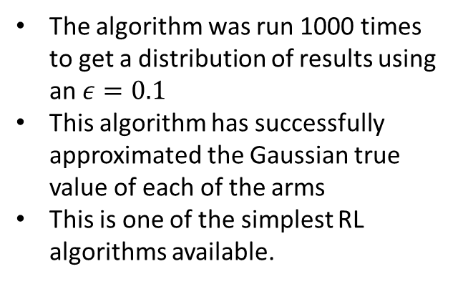
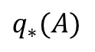
$K$-armed bandits (example from Sutton and Barto)
Results
The algorithm was run 1000 times to get a distribution of results using an $ε=0.1$
This algorithm has successfully approximated the Gaussian true value of each of the arms
This is one of the simplest RL algorithms available.
$$q_{∗}(A)$$
[0.254, 0.474, -1.497, -0.561, 1.537, 0.941, -0.191, 0.203, -0.452, -1.051]

